Slide 1
Boosting Algorithm:
Boosting is an ensemble learning method that combines a set of weak learners into a strong learner to minimize training errors.
The boosting algorithm assesses model predictions and increases the weight of samples with a more significant error. It also assigns a weight based on model performance.
Boosting algorithm are based on the idea that a group of people is better at decision-making than an individual.

Slide 2
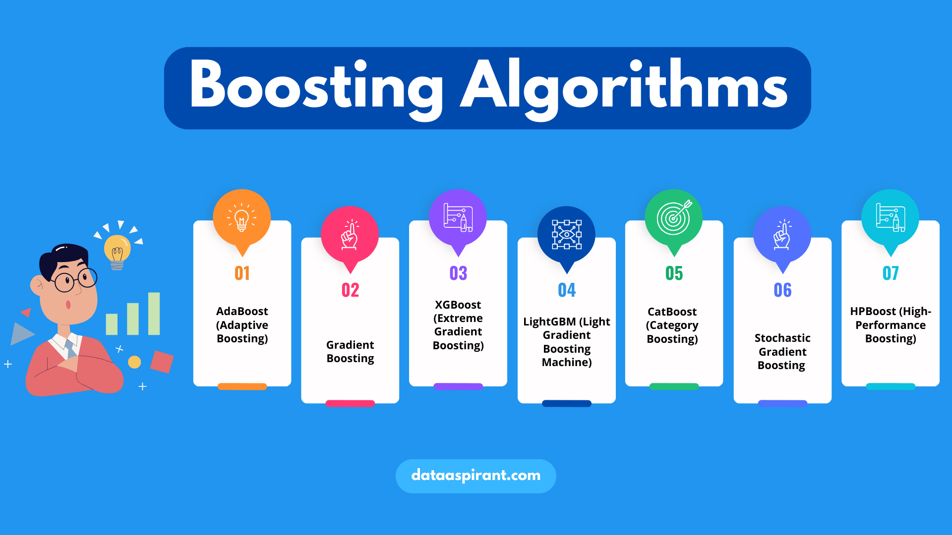

Slide 3
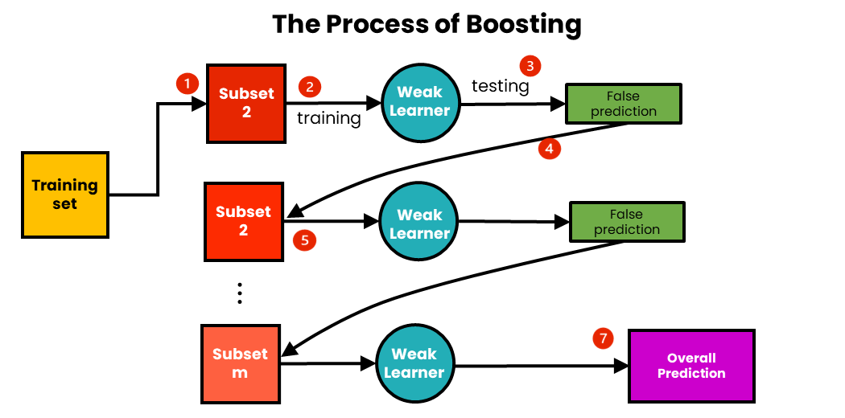

Slide 4
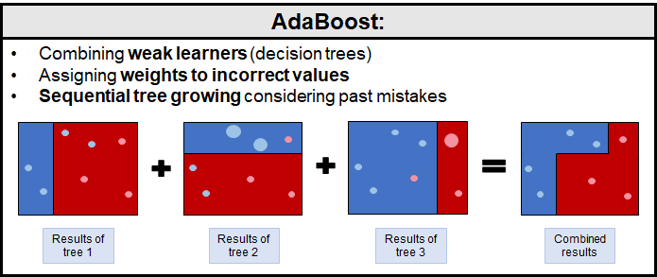

Slide 5
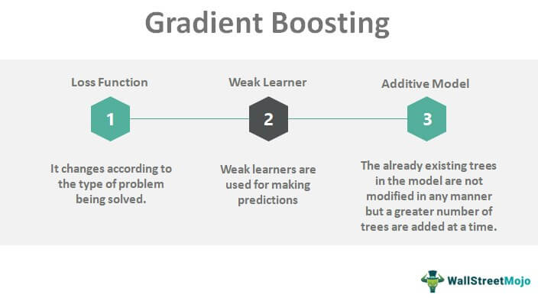

Slide 6
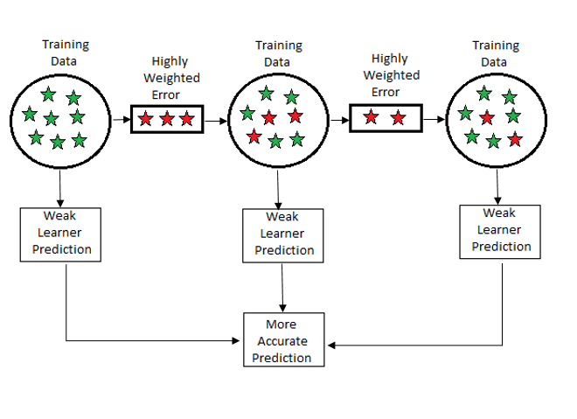
Gradient Boosting Algorithm

Slide 7
R- Score value using Boosting Regression Algorithms:
Ada Boost Regression : 0.84474
Extreme Gradient (XG) Boost Regression : 0.865284
Light Gradient (LG) Boost Regression : 0.866031

